Slide 1
Meeting the Needs
October 27th, 2016
Supporting Students With Learning Disabilities in Math
Heidi Ferguson
Tracy Joyce
RCCDSB

Slide 2
History: How we got here?
Questions surfacing about accommodations and modifications in math
Need for consistency between schools in developing learning expectations in IEPs
Need for Diagnostic Tools in Mathematics for SERTs
Special Education Teachers needed support to better understand effective math instruction
Connie Quadrini: Supporting students with learning disabilities in mathematics - this connected to some of the work we were doing around psycho-educational assessments
Notes:
Tracy

Slide 3
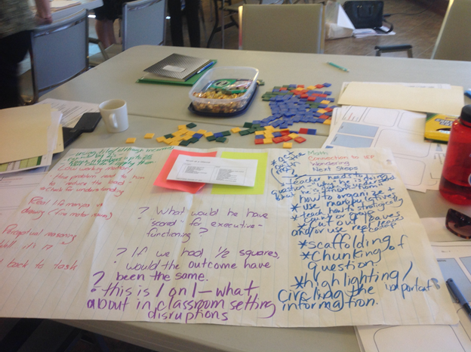
Investing in SERT/Teacher Training
Notes:
Tracy

Slide 4
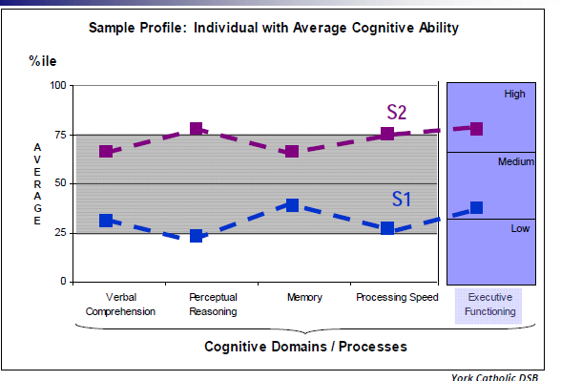
Understanding the Learner Profile
The psycho-educational assessment
The cognitive domains and processes
What is a learning disability and how is it diagnosed?
Many of the following slides from Adobe Connect Series at Edugains
Notes:
heidi

Slide 5
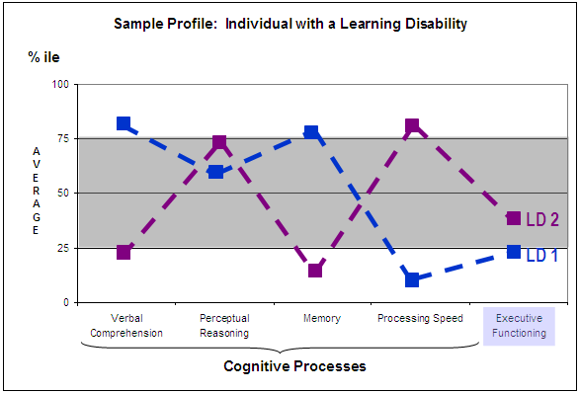
What might an LD profile look like?

Slide 6
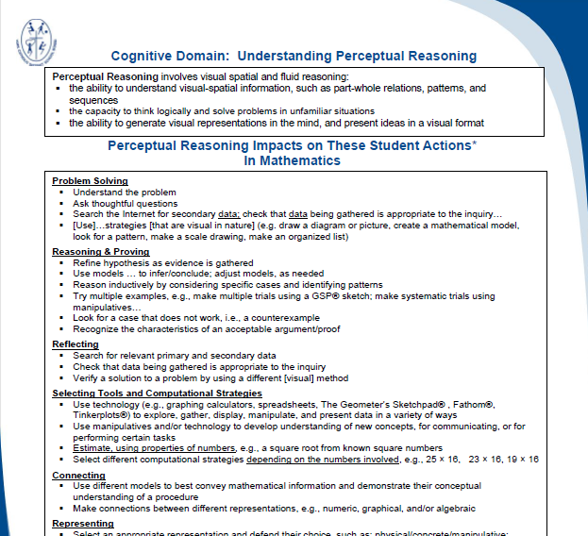
Understanding the Cognitive Domains and Processes
Verbal Comprehension
Perceptual Reasoning
Processing Speed
Working Memory
Executive Functioning

Slide 8
Notes:
this is what a student might experience with a low verbal comprehension score - click rectangle for the answer

Slide 9
From Calculus to Primary
Imagine a student reading this…
Read this individually and
be prepared to summarize:
Usually, we tend to associate increasing rates with graphs that become “steeper”. This is correct when the function is increasing itself and the slopes are positive. However, when the function is decreasing and the slopes are negative, the increase of the steepness of the graph means that the magnitude of the slope increases, thus, the number becomes “more negative” and the actual value of the slope is
decreasing.
TIPS4RM, Calculus and Vectors: MCV4U - Unit 4: Rate of Change Problems, Page 13
Notes:
actual examples from text books that might be difficult

Slide 15
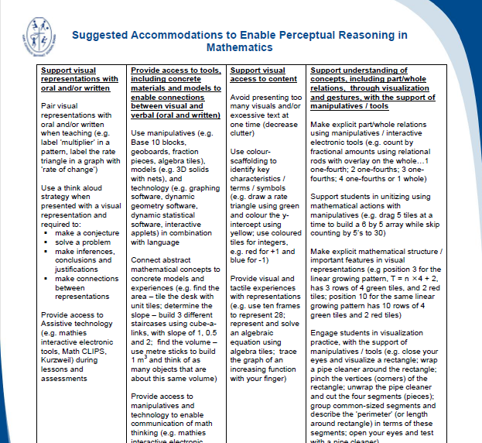

Slide 17
Processing Speed
Requires visual perception and organization, visual scanning, and hand-eye coordination
Assesses ability to focus attention and scan quickly, and the ability to discriminate and order visual information
Requires persistence and planning
Sensitive to motivation, time pressure, and coordination
Related to working memory (i.e., decreased processing speed can negatively affect working memory processes)
Notes:
many facets in processing speed-look to the next four slides-visual and auditory processing

Slide 18
Processing Speed - how difficult would this be?
Notes:
Make participants do on paper- draw the shape with your dominant hand but use non dominant hand to complete the reflection- cognitive load- constantly looking back and forth to the board and time and accuracy (Note that this is an EQAO question)

Slide 20
How could we modify this to support all learners?
Executive Functioning and Working Memory
Notes:
Next slides show how a few modifications to a problem can support all the cognitive processes.

Slide 21
Organizing, chunking, decreasing the load….

Slide 22
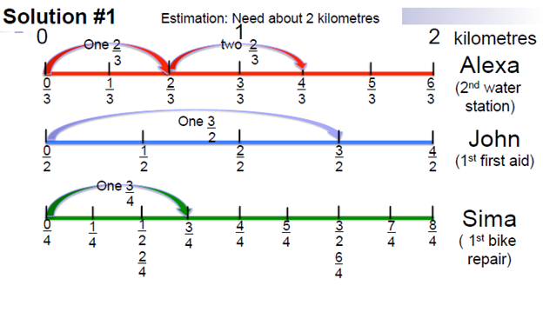
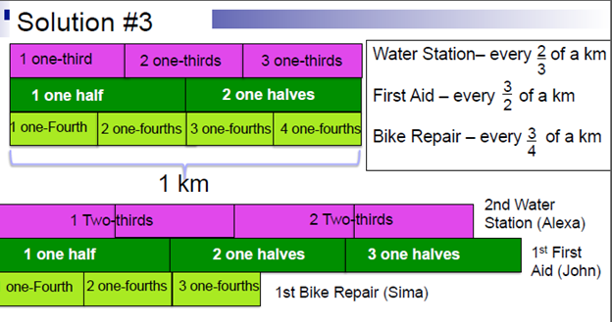
Technology
Supports
Manipulatives
Supports for student thinking
Notes:
Heidi stops

Slide 23
Minds on: How would you describe the
relationship between the 2 sets of leaves?
Notes:
Tracy
how many more on the right than left?
How many more times are the leaves on the right compared to the left
what is special about how the leaves on the right are arranged?
what number sentence would you use to describe the relationship between the 2 sets of leaves
what fraction of teh leaves on the right are on the left?

Slide 24
Action: Mrs Ferguson loves caterpillars. She needs 5 leaves each day to feed her 2 caterpillars. How many leaves would she need for 12 caterpillars? Solve the problem in 2 different ways
Notes:
How does this link to the minds on?
How might you make your thinking more visible?
Lesson goal could include understanding of rate or emphasizing the multiplicative nature of the realtionship

Slide 25
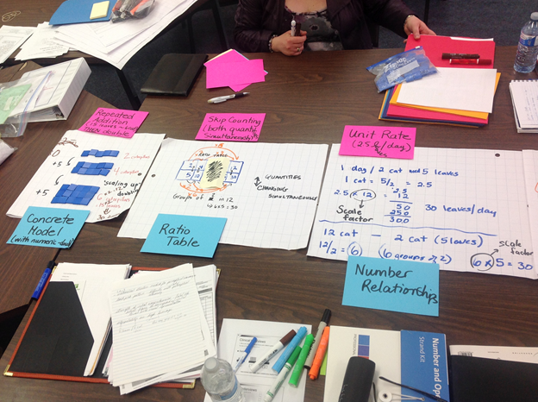
Teacher Samples

Slide 26
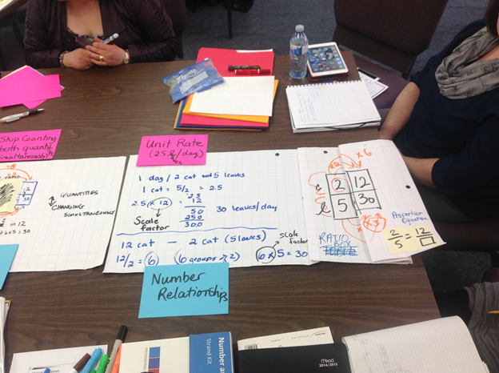

Slide 27
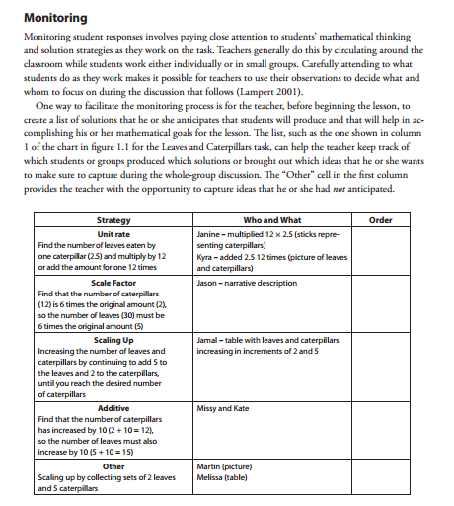

Slide 28
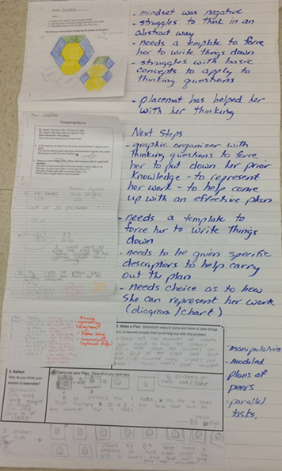
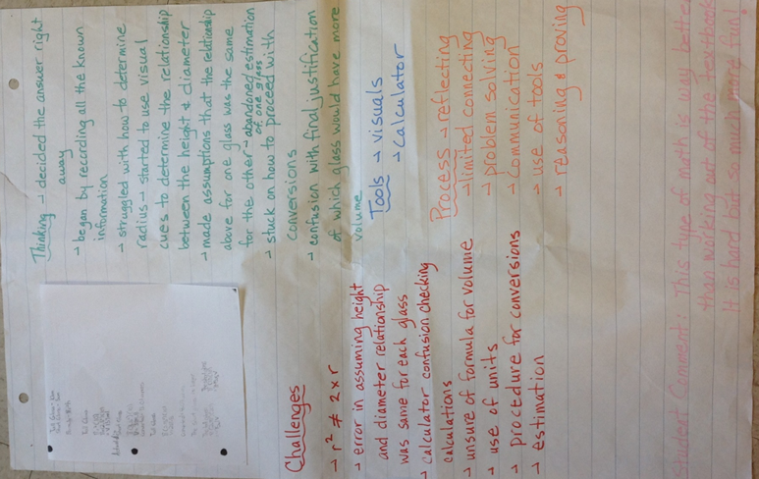
Annotating Student Work
Teachers in the board have been using annotation of student work with headings of
Thinking,
Challenges,
Math Processes, Math Tools
Notes:
Working on in the board- Cathy Bruce annotation suggestion - tracking student progress- in class observations and over a longer period of time

Slide 29
Annotating Student Work with CASL
(Collaborative Analysis of Student Learning)
Math
Connection to IEP
Wondering
Next Steps
Notes:
Great lead in to working with Connie Quadrinni

Slide 31
CASL
CASL-focused on supporting student’s strengths and needs
Notes:
Tracy ends
we will be looking at annotating with the student’s IEP in mind and look for how to support the student or listen to the students thinking

Slide 32
Video Observations - Math, Connection to IEP, Wondering, Next Steps
1:31- Strength-
He likes to please, likes working with adults, eager to read the question but his Need is support with reading comprehension.LD in reading, low verbal comprehension, gap in reading comp.
Wondering-
Is he able to decode and understand the problem?
Next Steps-
Check for understanding -student could rephrase, highlight key info? (Question was on paper and the computer screen, in colour.)
Notes:
Tracy
STOP at 1:31

Slide 33
As you watch the video…….
Using the template, jot your ideas that you will need to complete the CASL process

Slide 34
Video Observations - Math, Connection to IEP, Wondering, Next Steps
3:16 Math
-counting and representing (drawing triangles)
Strength-
representing his thinking, confidence, perceptual reasoning (19th percentile)
Needs-
attention to details of the question, decoding, working memory (0.3 percentile)
Wondering-
Did he just add up all the numbers he saw in the question? Did he create his own visual to decrease the load?
Next Steps-
Strategies to make sense of the problem.
Notes:
STOP at 3:16

Slide 35
Video Observations - Math, Connection to IEP, Wondering, Next Steps
4:51 (still trying to decode the question)
Math -
Tried addition and multiplication strategies
Needs
-Working Memory 0.3 percentile, difficulty organizing and planning, ADHD- attention to details, executive functioning
Wondering-
Does he know what to do with the numbers? Caught up in the idea that EACH caterpillar needs 5 leaves instead of each day I need 5 leaves for 2 caterpillars.
Next Steps-
Teach strategies to decode the problem and highlight key info from the problem, teach key words (meanings)

Slide 36
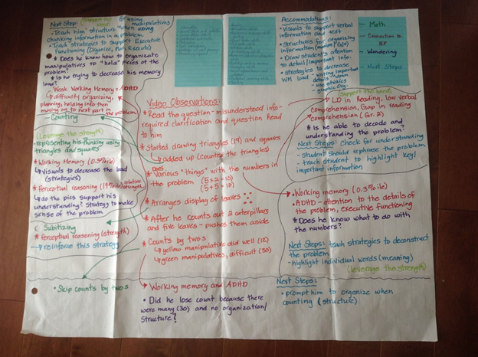
CASL Annotation (Second Review)

Slide 37
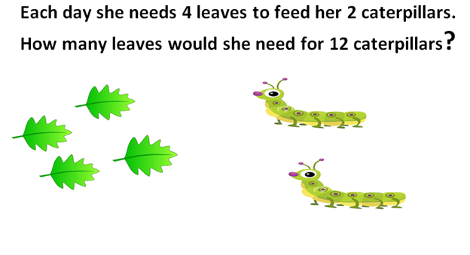
Second CASL ATTEMPT
The Second Session - reworded the question due to the length of time for decoding

Slide 38
Second Session Highlights
(Using our learning from the CASL)
Teacher Moves- highlighter, question
on paper and in colour, ledger paper,
after he wanted to read the question, it was read back to him and he was asked what his plan would be, checking for understanding, after only looking at one sentence at a time.
Pushed away the ledger paper and pencil and went for the tiles
Cooperatively, we highlighted parts of the question
Created the yellow caterpillars and 2 green tiles (leaves) for every caterpillar

Slide 39
When more caterpillars had to be introduced he could make the connection (with some assistance), of 2 leaves with each caterpillar but added the leaves one at a time, needing more support to develop
the relationship of
2 leaves / 1 caterpillar

Slide 40
Got to 6 but didn’t recognize that he could Now adding 4 leaves and
double to get answer. 2 caterpillars at a time
Improved organization of tiles Additive relationship
Notes:
started adding groups of------ 2 caterpillars and 4 leaves at a time ------recognized this relationship

Slide 41
Modelled out (his configuration) but now has some difficulty with counting up the leaves and where he started counting. Teacher move-Used a pencil to show his starting point. (This helped in his counting as he was forgetting where he started)
Notes:
Then started using a circle- reminded him of a clock. Had lots of difficulty counting around the circle. Teacher move- Suggested a pencil as a starting point. When asked if there would be an easier way to show his thinking (getting all confused with starting point) he chose this configuration. When asked how many leaves for 4 or 6 caterpillars, he could easily respond-additively

Slide 42
When asked if there would be an easier way to show his thinking (getting all confused with starting point) he chose this configuration. When asked how many leaves for 4 or 6 caterpillars, he could easily respond-additively
5 on 1 side, 7 on the other

Slide 43
Session Three
Grade 5

Slide 44
Caterpillar-Extended
Session Three

Slide 45
Minds On
Group 1 Group 2
Notes:
How could you describe the two sets of dogs?

Slide 46
How many biscuits?
The Petawawa SPCA has many dogs in the kennel. Two dogs eat 5 biscuits.
How many biscuits would be needed if they had 12 dogs?
Notes:
As a scaffold if needed- ask for 6 dogs.

Slide 47
Wonderings...
How to assist with understanding the question?
How to effectively use the manips/organized work space?
Modelling with tiles= transfer to T chart?
Would this help with seeing a pattern, thinking of units, multiplicative thinking
How to promote unitizing?
How to build the foundation for future work with fractions etc?

Slide 49
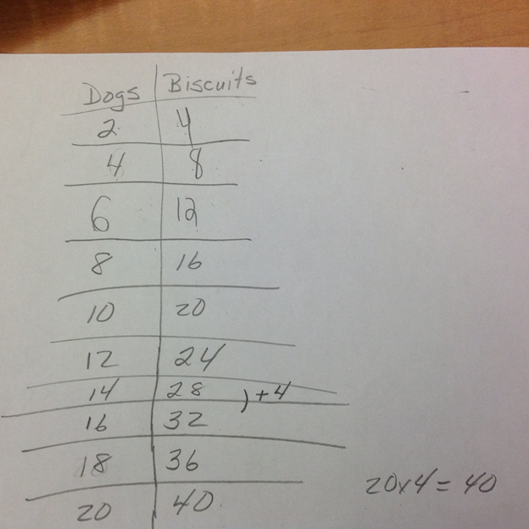
Final Video
Structure to support working memory, organization and attention
Modelling with tiles and transfer to
T chart
Able to predict and generalize
somewhat - some confusion when
pushing questioning past very
predictable pattern

Slide 50
Individual Task in Classroom- 6 deeds every 4 days, how many in 32 days?
Back in classroom-
misconception
multiplied 6 X 32
Re-directed to try t-chart

Slide 51
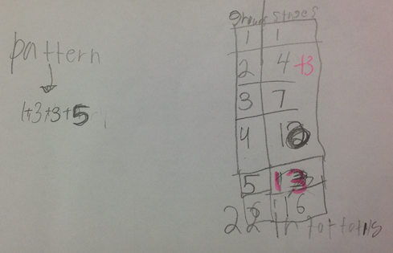
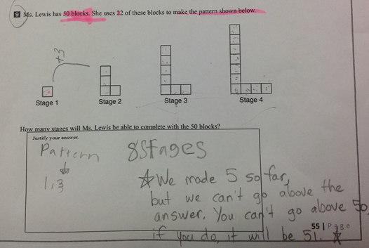
Noah in Grade 6-EQAO Question

Slide 52
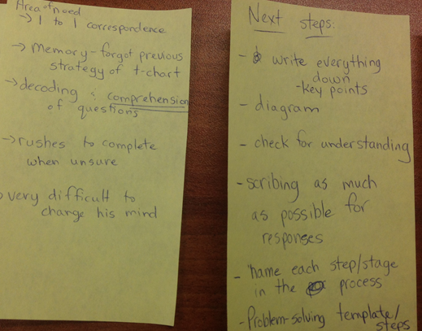
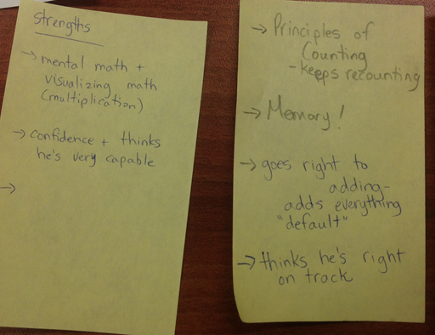
CASL on Stickie Notes

Slide 53
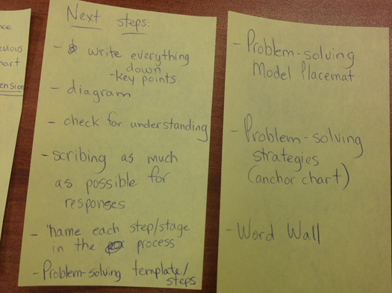

Slide 54
Classroom Application
We tried to extrapolate the learning from the CASL to think about how these strategies might help in planning for a whole class investigation.
The idea was that perhaps some of these strategies might be necessary for some but good for all. Our observations follow:
Notes:
Tracy

Slide 55
Classroom Application (23/11IEPs, 2LD)
Based on the CASL process with this student, we identified the use of highlighters, chunking and deconstructing the question to help ensure understanding to be key. We also identified the use and organization of manipulatives (2 colours) as being important to his understanding. Another important point was that when we created a parallel task to the original question the student had much more success. This seemed to be necessary for him.

Slide 56
Some students still required further scaffolding than what was presented in the lesson with trying to deconstruct the question before making a plan as to how to solve it.

Slide 57
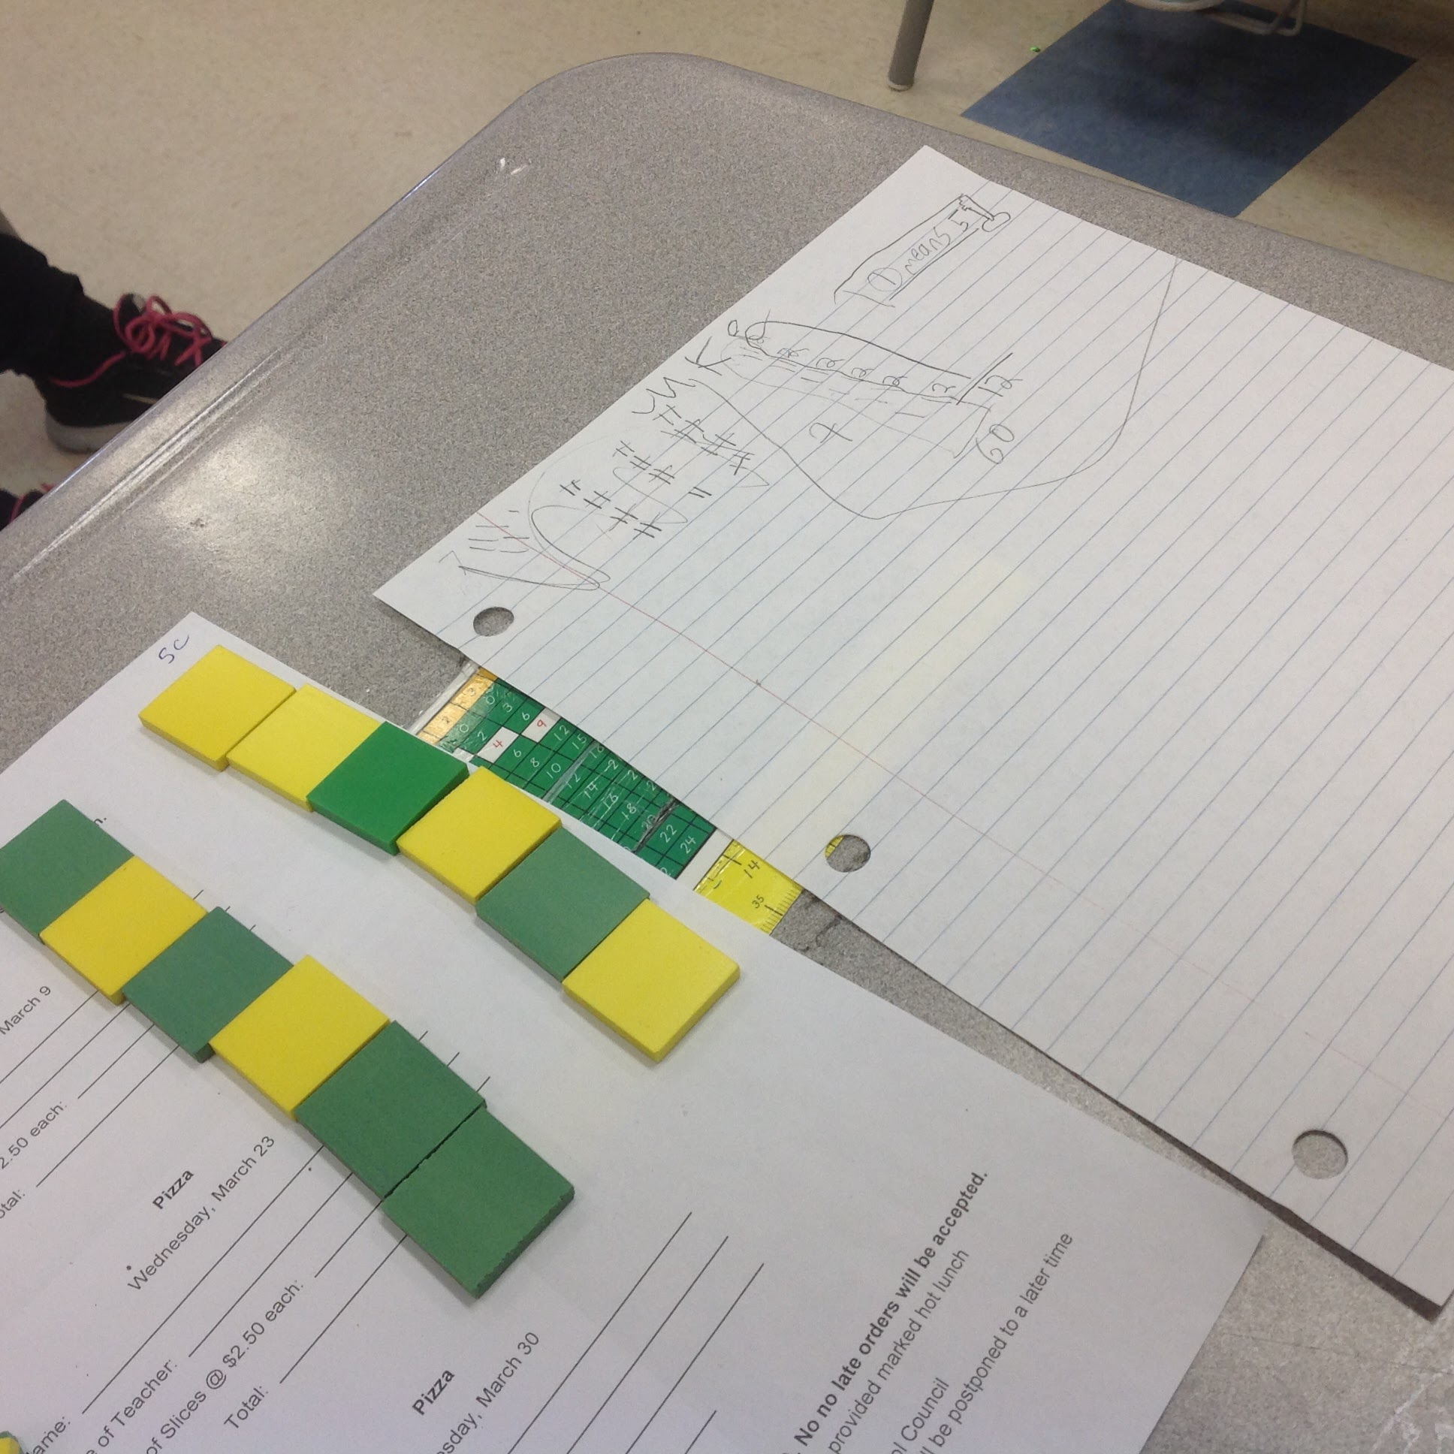
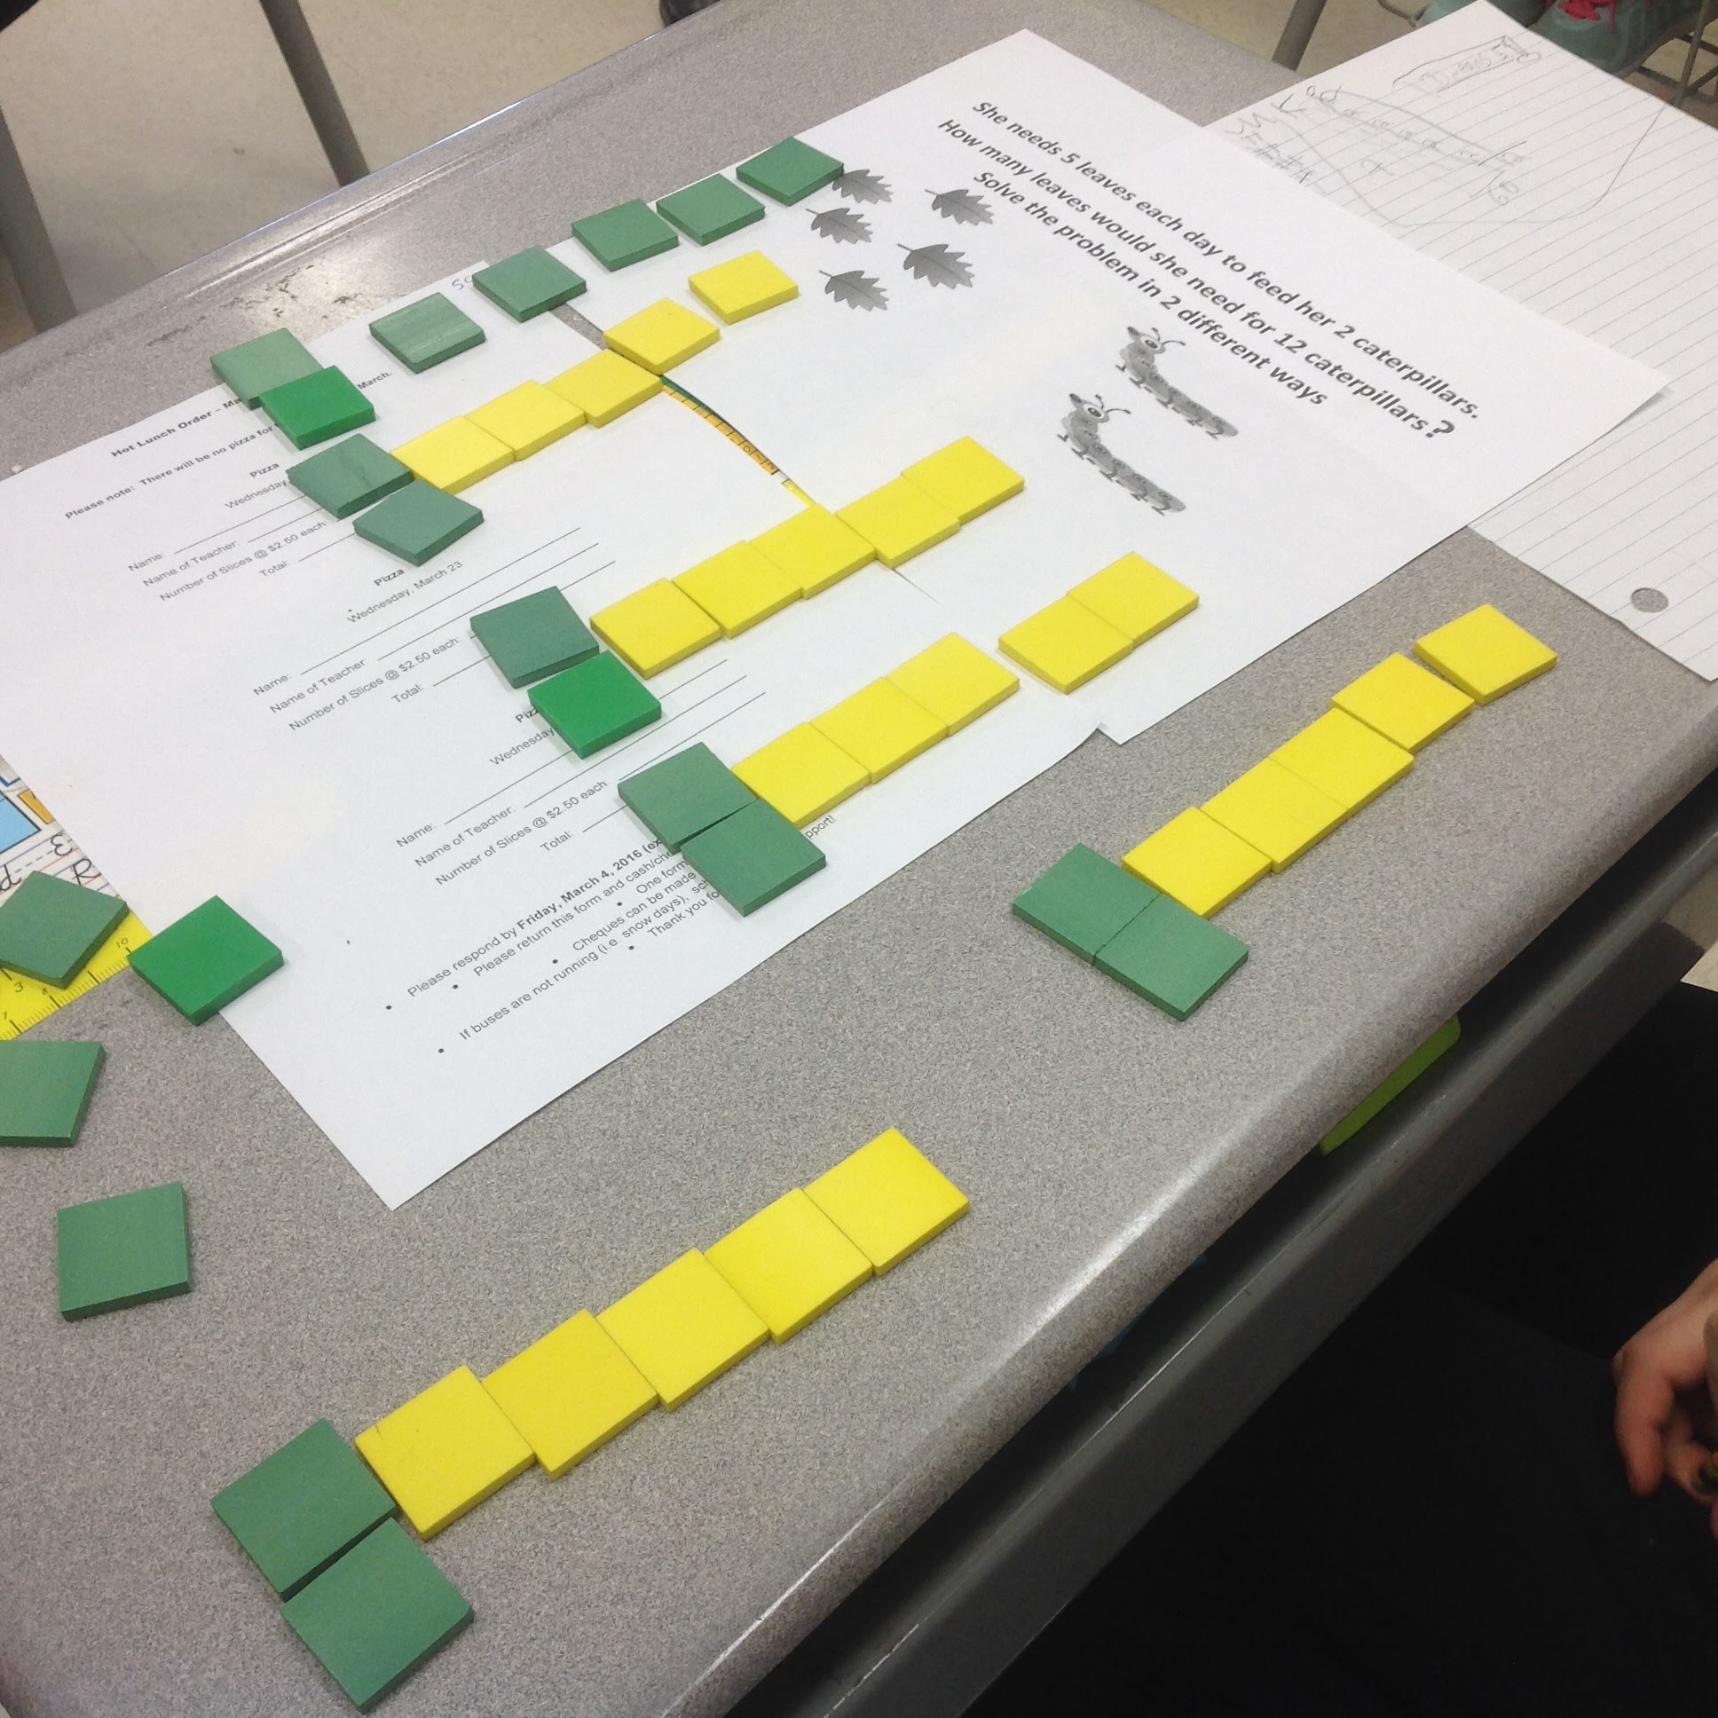
We observed some students requiring assistance with how to organize the manipulatives so that they might be useful in helping to visualize the relationship between numbers in this proportional situation. Some students built representations with the tiles that were clear and helpful to assist their solution and to communicate it.

Slide 58
Further Classroom Observations and Wonderings
Some students who used drawing pictures as a strategy required assistance moving from the visuals to actual numbers.
Some students established unit rate, some used drawings, some symbols, some tiles to represent the situation, repeated addition, skip counting, multiplication, tally charts and t charts
The variety of strategies the students used to attempt to solve the problem demonstrated the diversity of thinking of the students. Honouring that is where attention to effective DI is so important to ensure success.
I wonder if we could have used a few more parallel tasks for a few students. Spending more time deconstructing the question and instruction on how to use the tiles appropriately were points that we tried to support as the students worked.

Slide 59
Further Spread in RCCDSB

Slide 61
Heidi Ferguson
hferguson@rccdsb.edu.on.ca
Tracy joyce
tjoyce@rccdsb.edu.on.ca
Notes:
providing lots of varied math tools

Slide 62
providing lots of varied math tools to support learning style
Notes:
providing lots of varied math tools

Slide 63
Organizing, chunking, decreasing the load….

Slide 64
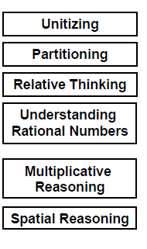
Fraction concepts covered in the bike a thon question
supported many diverse needs

Slide 65
Works Cited
Teacher’s Gateway to Special Education (OTF)
http://www.teachspeced.ca/home
Supporting Students with Learning Disabilities in Mathematics (Connie Quadrini, Provincial Math Lead) - powerpoint presentation
http://www.edugains.ca/resourcesSpecEd/PLF/LearningDisabilities/StudentswLDinMath.pdf
Supporting Students with Learning Disabilities in Mathematics - A YCDSB Resource to Support Implementation http://www.edugains.ca/resourcesSpecEd/IEP&Transitions/BoardDevelopedResources/IEP/SupportGuides/Supporting_Students_Learning_Disabilities_Mathematics_Ycdsb.pdf

Slide 66
Works Cited (cont’d)
Math Gains - “Math Campp” sessions - Programming for Students with Learning Disabilities
http://www.edugains.ca/resources/PLF/MathCamppp/2012/K-4_Breakout/Day2_Breakout3_AugustParticipants.pdf
EQAO Students Assessment Booklets
http://www.eqao.com/en/assessments/junior-division/educators/Pages/example-materials.aspx

