Slide 1
INCREASING POSITIVE VISIBILITY OF CHILDREN WITH Autism spectrum disorder (ASD) IN MAINSTREAM CLASSROOMS: Inclusivity through children’s literature
Meeting the Needs Conference
sandra.odoherty@cdsbeo.on.ca
October 2017

Slide 2
I’m here. And you are there. And that’s okay, but maybe there will be a gentle wind that pulls us together. And then I’ll be here and you’ll be here, too.
Reynolds (2011) about his children’s book,
I’m Here … a story about autism.

Slide 3
The purpose of this session
Examine how educators can create positive social perceptions of Autism Spectrum Disorder (ASD) within mainstream classroom communities by exploring an inclusive approach, grounded in the field of early childhood education and children’s literature.

Slide 4
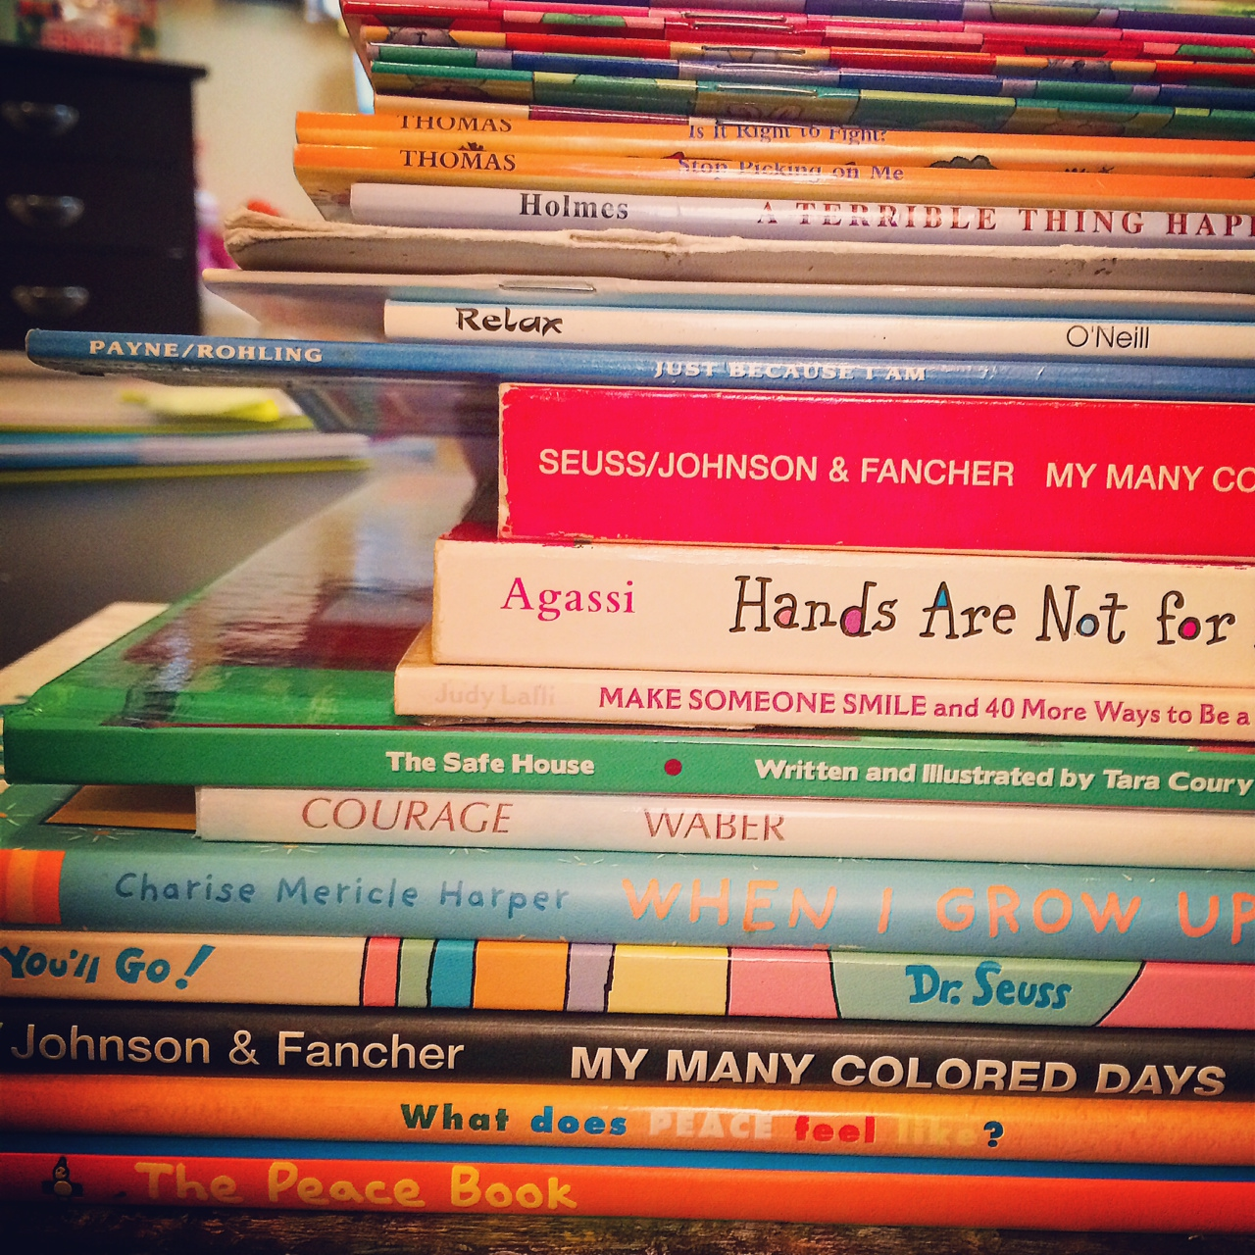
We’ll do this by …
Exploring current research on children’s literature in relation to exceptionalities-focus ASD
Bennett (2009); Nasatir and Horn (2003); ON Ministry of Education (2006-2012); Wasserman (2014)
Reading and listening to children literature, and discussing their important messages
Collaboratively sharing ideas, thoughts, and practices

Slide 5
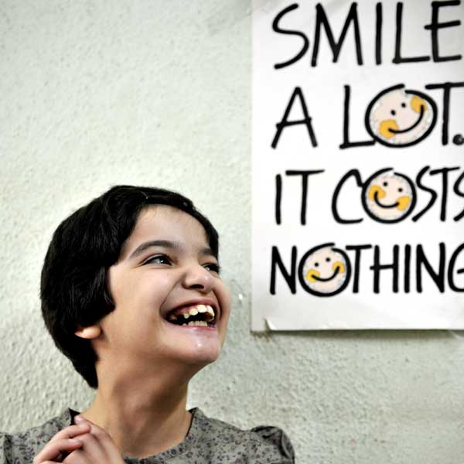
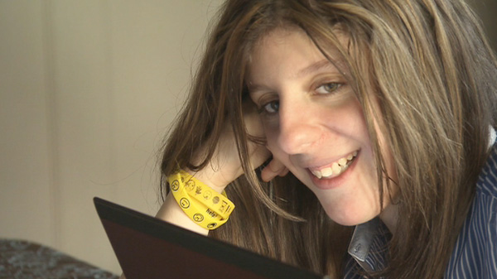
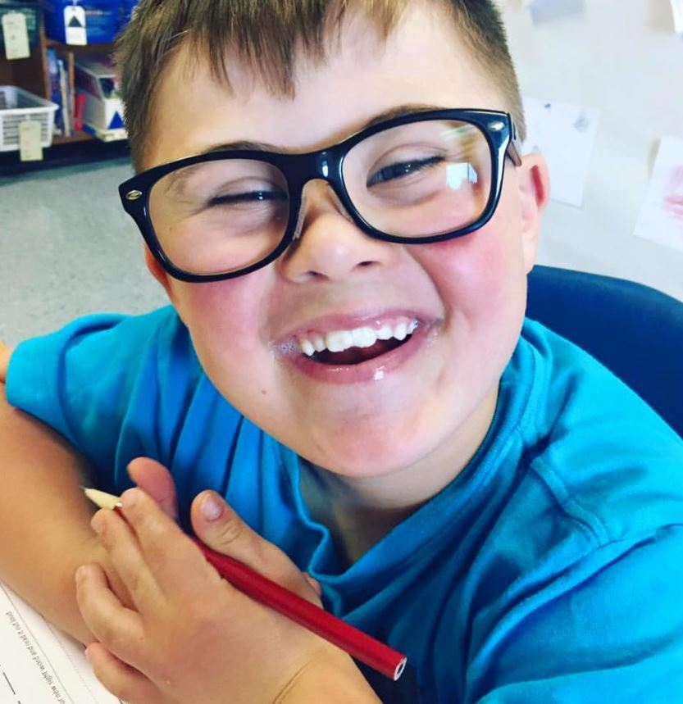
Overview
“Today’s classrooms bring us face to face with the reality that we, as educators, teach more diverse student populations than ever before”. (Bennett, 2009)

Slide 6
overview
Statistics collected from school boards throughout the province of Ontario, “most students with ASD spend at least 50 percent of their instructional day in a regular classroom, being taught by regular classroom teachers.” (Ontario Ministry of Education, 2009)
Based on current trends in education – increasingly inclusive school environments – this percentage will only increase.

Slide 7
overview
In a recent study of loneliness, friendship quality, and the social networks of children and youth with ASD (level 1), nearly 50% reported that they:
feel they do not belong in their class
feel lonely
feel socially isolated
Government of Canada, 2013; Locke et al., 2010
This study is troubling as ASD:
is now recognized as the most common neurological disorder
the majority of children attend “mainstream” classrooms
are at an increased risk for social exclusion

Slide 8
overview
One can easily understand the importance on creating inclusive classrooms where all students feel accepted.
Nonetheless, educators feel challenged in how to create inclusive classrooms where all students feel accepted …. where friendships thrive.

Slide 9
research by Laura Wesserman (2014)
Educators use a variety of strategies to make their classrooms more inclusive for all students including:
The use of technology - assistive technology
The use of grouping - pairing students with differences (strengths)
Understanding and using multiple intelligences - (Gardner’s theory, 2006) eight intelligences of the human brain or different learning styles and intelligence
Connecting curriculum to students’ interest - making connections between what is being taught and student interest
Connecting with colleagues - sharing ideas and learning with each other
Notes:
Eight intelligences are: musical – rhythmic; visual – spatial; verbal – linguistic; logical – mathematical; bodily – kinesthetic; interpersonal; intrpersonal; and naturalistic (Garder 2006)

Slide 10
But, when we really want inclusivity …

Slide 11
Inclusivity
Educators teach core values in life
Sharing – thoughts, feelings, fears, laughter etc.
Generating discussion and open discussion with all students
Encouraging understanding and empathy
Acknowledging differences and most importantly, similarities
Allowing students to ask, to question, to discover ….
to build awareness
Many use children’s literature as part of this important process

Slide 12
What does inclusion look like? How can it be defined?

Slide 13
Inclusion – a definition (McMaster, 2012)
There is no one single definition of inclusion
Viewed like a spectrum rather than a measureable goal
All classrooms are unique as the students who are in them
The inclusion strategy in place in each classroom should reflect the individual needs of the students
Inclusion began as a “practice of integration” or mainstreaming special needs students
Now inclusion is “concerned with the quality of participation, and that all of the students are participating”

Slide 14
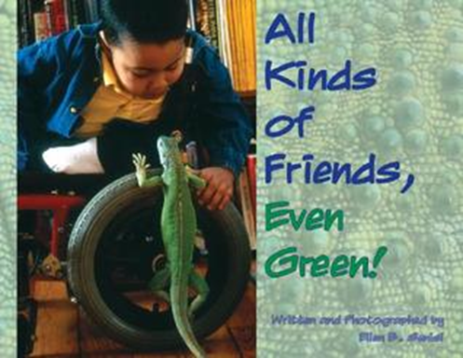
Inclusion (McMaster, 2012)
Inclusion is no longer just a special education issue; it involves everybody
Inclusion is having each student bring their individual uniqueness, to a place where everyone can be (Anonymous)

Slide 15
The Social perception of asd

Slide 16
Social perception of ASD-research
Typically developing children report generally negative social perceptions associated with ASD. Han, Ostrosky & Diamond, 2006; Higgins, MacArthur & Kelly, 2009; Martinez & Carspecken, 2006; Nabors & Keyes, 1997; Nowicki, 2006
These wide-ranging perceptions form as early as kindergarten.
Levy et al., 2006, Odom et al., 2006; Yeong, Ostrosky & Fowler, 2012
Despite the fact that research findings have led to deeper understanding of ASD, negative social perceptions have remained.

Slide 17
social perception - research
Why this negative social perception?
Children with ASD can display behaviours that are not easily understood by peers
confusing
troublesome
Typically developing children are often at a disadvantage because they may not,
have knowledge about ASD
understand capabilities of children with ASD
When they acquire the knowledge, attitudes shift
Ison et al., 2010; Rillotta & Nettelbeck, 2007; Frederickson, 2010; Han, Ostrosky & Diamond, 2006; Nowicki, 2006

Slide 18
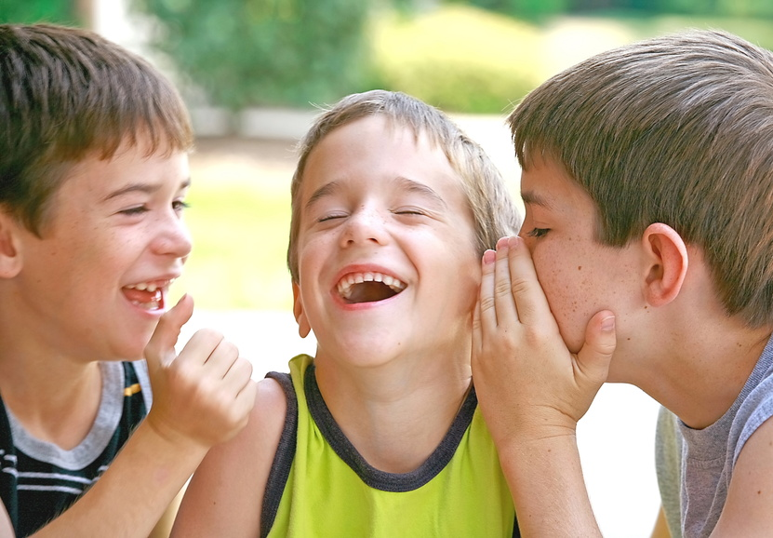
Social perspective - research
Children’s social perceptions are developed through direct and indirect experiences (Odom et al., 2006; Brownwell, Zerwas & Blaram, 2002).
Direct experiences - interactions and experiences across a range of play and learning contexts and
Indirect experiences - engagement with materials, (e.g. videos, television, print material, such as story books).

Slide 19
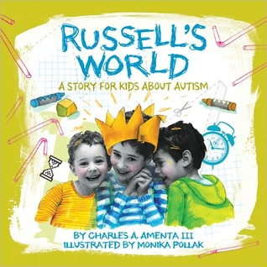
Social perception of ASD
Understanding the underpinnings of the negative social perceptions of [ASD] may help shift a school culture from one that is at times based on misunderstanding, to one that welcomes and accepts children with [ASD] as friends and members of a classroom community.
UNICEF REAP Project Rieser, World of Inclusion

Slide 20
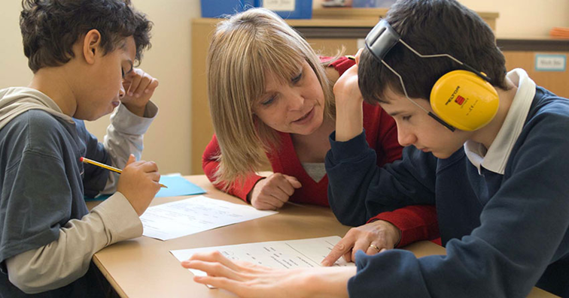
social perception - research
Well-designed awareness interventions can help improve positive social perceptions of ASD
Lindsay and Edwards (2013) remind us:
Educators should carefully choose an appropriate intervention to meet the needs of children in their class while considering age appropriateness and diversity of the students. It is also important for educators to be cognizant of the broader societal influences that impact attitudes towards [autism]. (p. 633)

Slide 21
Collaboration-School team, parent(s), and the child

Slide 22
Shifting social perception – why we are here today

Slide 23
Shifting Social perspective
Primary classroom settings
ideal environment to foster positive social perceptions toward children with ASD
Social behaviour is:
most impressionable and malleable during the early years at school
positive perceptions that develop early may have a positive impact throughout childhood and into adulthood
(Brown et al., 2008; Brownell, Zerwas & Blaram, 2002; Diamond & Hestenes, 1996; Diamond & Hong, 2010; Diamond & Tu, 2009; Favazza & Odom, 1996/1997; Maich & Belcher, 2012).

Slide 24
Shifting Social perspective – Nasatir & Horn (2003)
When educators incorporated literature featuring characters with disability:
substantial and lasting shift in children’s perception toward individuals with disability
Literature can provide a powerful influence on beliefs and can refute stereotypes and construct positive images about people with disabilities in the mind of the reader (p. 8).

Slide 25
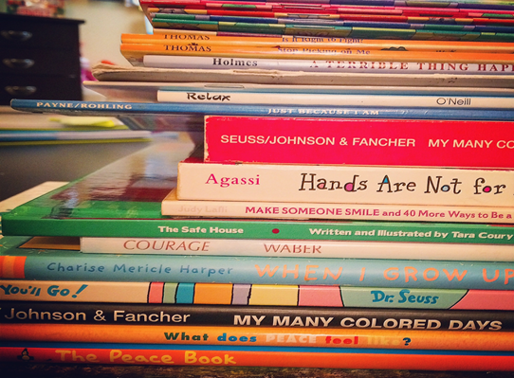
Why we are here today
Using appropriate literature can help establish a positive classroom … celebrating, honoring, and respecting differences of the characters in the texts lays down the foundations for recognizing and respecting individuals differences within the classroom community Kent & Simpson , 2012, p. 29

Slide 26
Disability as part of diversity
Children’s literature that includes images of children with disabilities can be organized in two different ways (Nasatir & Horn, 2003)
Simply addresses disability as a part of diversity - children with disability are shown in books doing the same things as children without disability.
Usually there is a character that has a disability; however the plot does not specifically focus on issues of the disability and/or its impact on the person.

Slide 27
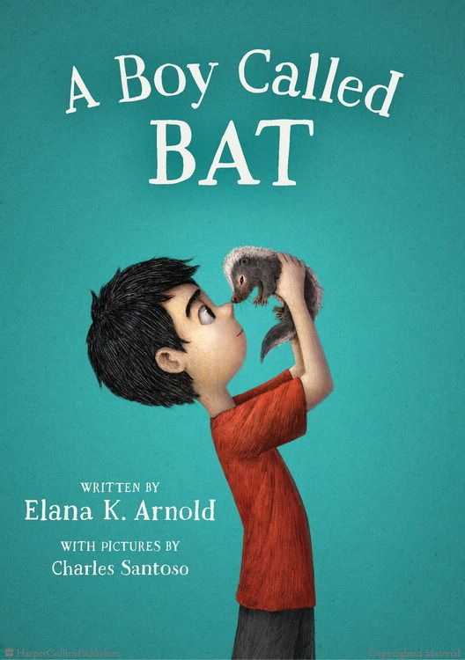
disability as a part of diversity
A Boy Called Bat by Elana Arnold
Alexander Tam’s veterinarian mother brings home a baby skunk to be kept only until its old enough to be released. Who would have thought Bat would want to keep the baby skunk, named Thor? Is it really okay for a skunk to become a pet? Bat is a unique character and the story offers a deeply heartfelt glimpse into the life of a boy on the autism spectrum.

Slide 28
Disability awareness
Children’s literature that includes images of children with disabilities can be organized in two different ways (Nasatir and Horn, 2003)
Designed to discuss disability in order to help support disability awareness as well as to provide specific knowledge about the “impairment” and its impact on a person.
Usually one of the main characters has a disability, and the plot focus on the character’s disability and the impact on the person and/or others.

Slide 29
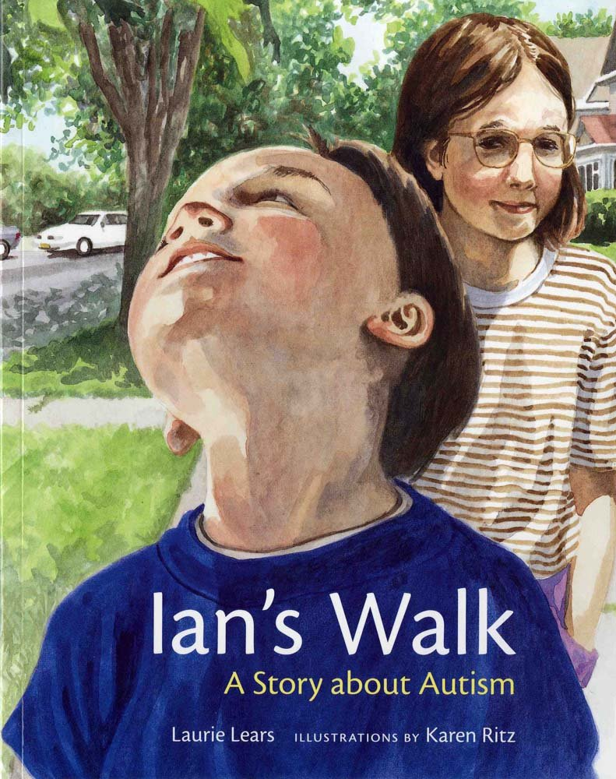
Disability awareness
Ian’s Walk: A story about autism by Laurie Lears (1998) is about a young girl and her brother who has autism. Julie and Ian go to the park, and it is through this experience that she learns more about her brother and the way autism is part of his life. Although Julie has questions and shares concerns about autism, her unconditional love for Ian is truly apparent. Ian’s Walk: A story about autism is specifically designed to address autism in order to impart knowledge and arouse reflection upon its audience.

Slide 30
Impact of using children’s literature to shift social perception

Slide 31
Children's literature & ASD
In primary grades,
may be a student’s first exposure to person with ASD
Using literature may help,
explain ASD and answer any questions due to a child’s natural curiosity
brings awareness
understand similarities and differences, and human diversities in the world in which they live
This understanding may extend beyond the classroom walls into the community at large.
Using picture books that have characters with [ASD] may help students understand their own feeling and reactions towards these individuals.
Prater et al., 2006, p.21

Slide 32
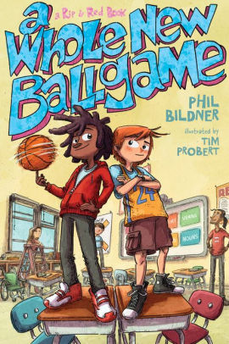
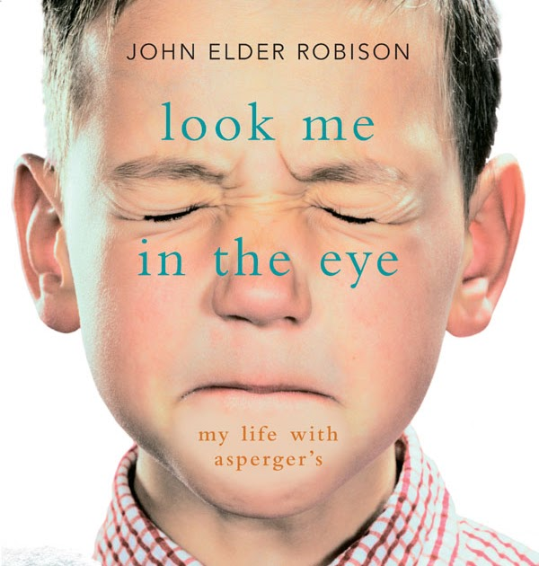
Children's literature & ASD
Helpful during difficult and sensitive conversations with students in a class
Help students empathize – see characters that resemble themselves or their community
Using children’s literature containing characters with ASD, allowing this topic within the classroom - giving permission

Slide 33
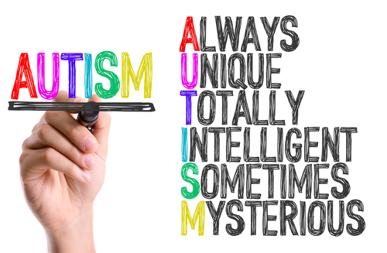
Portrayal of characters with ASD in children’s literature
It is important to remember,
portrayal of characters with ASD may not always be portrayed positively in children’s literature
As educators,
we need to be cognizant on how ASD is depicted
be prepared to address, misrepresentations and negative perceptions of ASD, with students

Slide 34
It’s okay to be different, Todd Parr

Slide 35
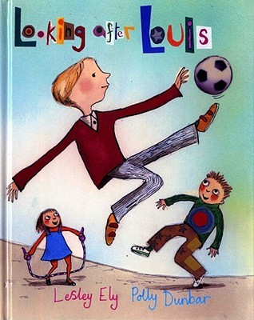
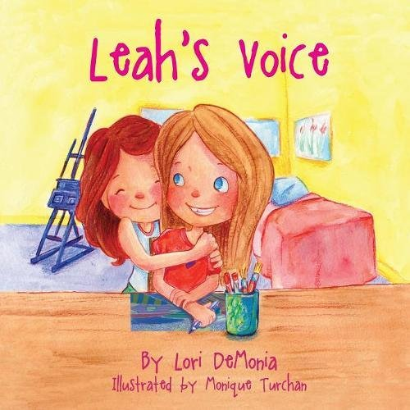
Impact of using children’s literature to shift social perception
Clearly, promoting positive social perceptions towards children with ASD in mainstream classroom communities is timely, and using children’s literature as a way to share powerful examples of diversity and acceptance seems fitting.

Slide 36
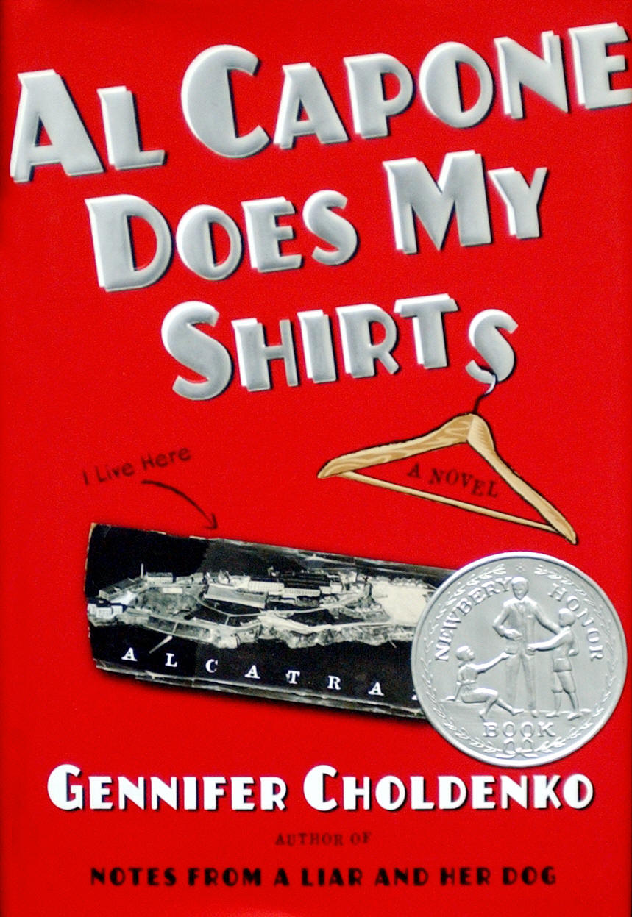
Impact of using children’s literature to shift social perception
Whether it is a story celebrating diversity as in Special People, Special Ways by Arlene Maguire (2000), or exploring ASD as in Al Capone Does My Shirts by Gennifer Choldenko (2004) or Padro’s Whales by Paula Kluth & Patrick Schwarz (2010), children’s literature is a concrete way of making the message meaningful and cultivating awareness of a largely misunderstood and often misrepresented human experience.

Slide 37
Let’s look at My Best Friend Will by Jamie Lowell & Tara Tuchel
What did you liked about the book?
What didn’t you like about it?
Would you read this book to your students?
How could you discuss it?
Score 1-5 (1 being the lowest score & 5 being the highest)
“Using appropriate literature can help establish a positive classroom … celebrating, honoring, and respecting differences of the characters in the texts lays down the foundations for recognizing and respecting individuals differences within the classroom community” (p. 29) Kent and Simpson (2012)

Slide 38
The Road we must travel

Slide 39
The Road we must travel
We have come to a fork in the road. There are two paths ahead. One sign posted ‘Exclusion’, the other ‘Inclusion’. They lead to different places. We must decide as a community which path to follow.
Anonymous

Slide 40
The Curious Incident of the Dog in the Nighttime (2003)
Mark Haddon

Slide 41
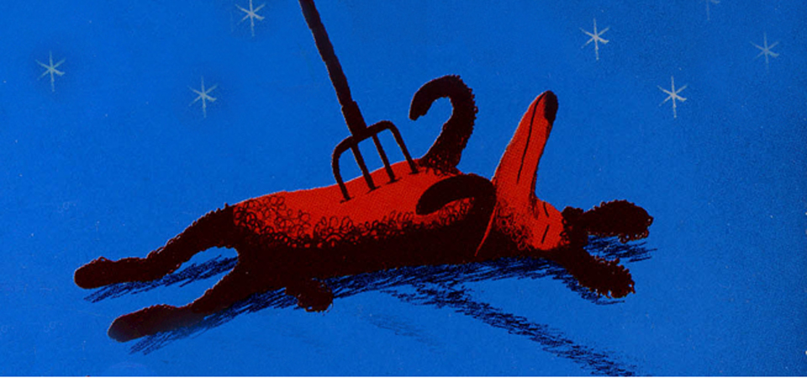
The Curious Incident of the Dog in the Nighttime, Mark Haddon (2003)
During his acceptance speech at the Dolly Gray Children’s Literature Award ceremony, Haddon shared this reflection:
I look forward to a time in the not too distant future when such prizes seem outdated and unnecessary, when children with autism of all kinds are as much a part of our society as children with red hair or children who play the clarinet and readers who do not even notice when a book contains a character with autism because such books are as common as rain.

Slide 42
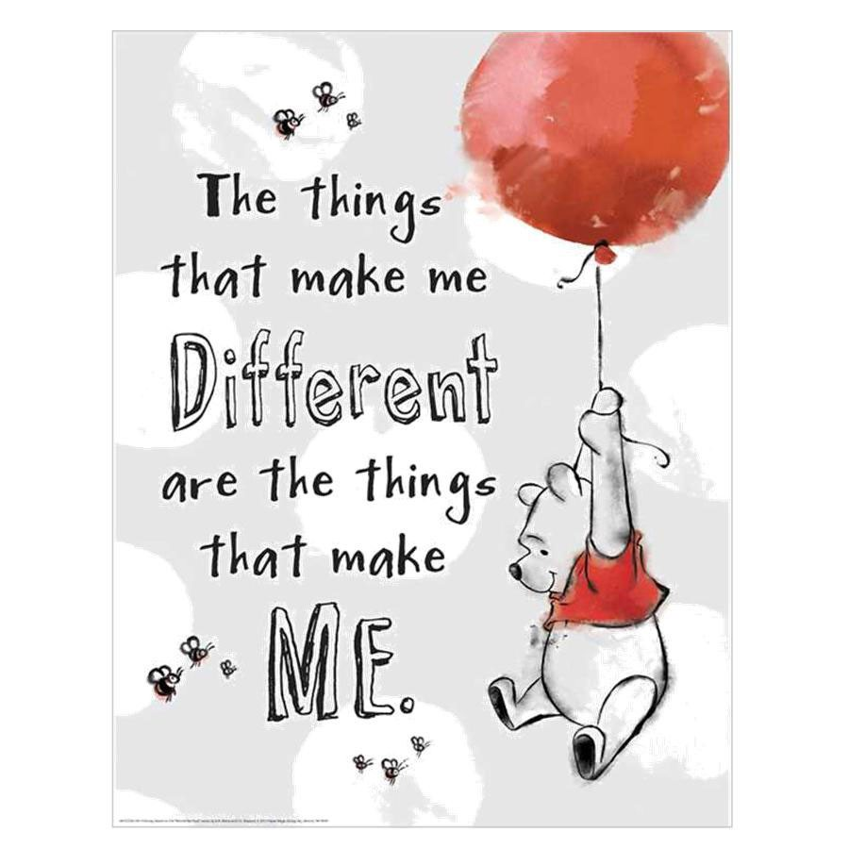
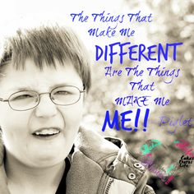
Questions or comments?

Slide 43
References
Bennett, S. (2009). Including Students with Exceptionalities. A research-into-practice series produced by a partnership between The Literacy and Numeracy Secretariat and the Ontario Association of Deans of Education. http://www.edu.gov.on.ca/eng/literacynumeracy/inspire/research/Bennett.pdf
Gaffney, M. & Wilkins, J. (2016). Selecting picture books featuring characters with autism spectrum disorder: recommendations for teachers. International Journal of Inclusive Education, 20(10,) p.1024-1031.
Gardner, H. (2006). Frames of Mind: The Theory of Multiple Intelligences. Basic Books. USA.
Google. (2017). Google images. Google Inc.
Han, J., Ostrosky, M.M. & Diamond, K.E. (2006). Children’s Attitudes Toward Peers with Disabilities: Supporting Positive Attitude Development. Young Exceptional Children, 10(2).
Higgins, N., MacArthur, J. & Kelly, B. (2009). Including disabled children at school: Is it really as simple as ‘a, c, d’? International Journal of Inclusive Education, 13(5), p. 471-487.
Kasari, C., Locke, J. Gulsrud, A., & Rotheram-Fuller, E (2011). Social Networks and Friendships at School: Comparing Children With and Without ASD. Journal of Autism and Developmental Disorder, 41(5), p. 533–544.
Kent, A.M. & Simpson, J.L. (2012). The power of literature: Establishing and enhancing the young adolescent classroom community. Reading Improvement, 49(1), p. 29.
Li, S., Sandal, S., Zercher, C., Marquart, J.M., & Brown, W.H. (2015). The Relationship Between Preschoolers’ Attitudes and Play Behaviors Toward Classmates With Disabilities, Topics in Early Childhood Special Education, 35(1), p. 40-51.

Slide 44
References
Martinez, R. & Carspecken, P. (2006). Effectiveness of a brief intervention on Latino children’s social acceptance of peers with special needs. Journal of Applied School Psychology, 23(1), p. 97-115.
Nabors & Keyes, (1997). Preschoolers’ reasons for accepting peers with and without disabilities. Developmental and Physical Disabilities, 7(3), p. 335-355.
Nasatir & Horn (2003). Addressing Disability as a Part of Diversity Through Classroom Children’s Literature. Young Exceptional Children, 6(2), p. 2-10.
Nowicki, E.A. (2006). A cross-sectional multivariate analysis of children’s attitudes towards disabilities. Journal of Intellectual Disability Research, 50(5), p. 335-348.
Odom, S.L. (2006). Social Acceptance and Rejection of Preschool Children With Disabilities: A Mixed-Method Analysis. Journal of Educational Psychology, 98(4), p. 807-823.
ON Ministry of Education (2006-2012) & Government of Canada (2013). (publications)
Prater, M.A. & Dyches, T.T. (2006). Books that portray characters with disabilities a top list 25 list for children and youth adults. Teaching Exceptional Children. 40(4).
Parentbooks. Toronto. Copyright © 2002-2017 Parentbooks .
UNICEF REAP Project. Rieser, World of Inclusion (2013). Lindsay and Edwards (2013). Teacher Education for Children with Disabilities Literature Review.
Wasserman, L. (2014). Teacher’s Use of Children’s Literature that Accurately Portrys Individuals with Exceptionalities in Inclusive Classrooms. A research paper., University of Toronto

